Slide 1

Sugeno fuzzy inference
Mamdani-style inference: find the centroid of a two- dimensional shape by integrating across a continuously varying function.
Not computationally efficient.
Michio Sugeno suggested to use a single spike, a singleton, as the membership function of the rule consequent.
A fuzzy singleton is a fuzzy set with a membership function that is unity at a single particular point on the universe of discourse and zero everywhere else.

Slide 2
Sugeno fuzzy inference (cont.)
Sugeno-style fuzzy inference is very similar to the Mamdani method.
Sugeno changed only a rule consequent.
Instead of a fuzzy set, he used a mathematical function of the input variable.
IF AND THEN
x is A
y is B
z is f (x, y)
where x, y and z are linguistic variables; A and B are fuzzy sets on universe of discourses X and Y, respectively; and f (x, y) is a mathematical function.

Slide 3
Sugeno fuzzy inference (cont.)
The most commonly used zero-order Sugeno fuzzy model applies fuzzy rules in the following form:
IF AND THEN
x is A
y is B
z is k
where k is a constant.
In this case, the output of each fuzzy rule is constant.
All consequent membership functions are represented by singleton spikes.

Slide 4
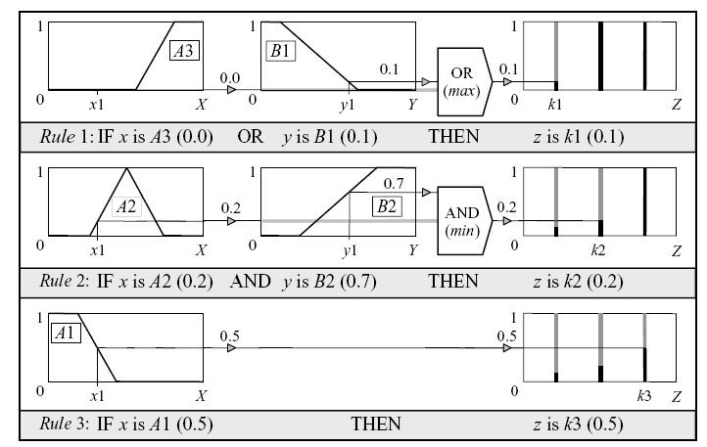
Sugeno-style rule evaluation

Slide 5
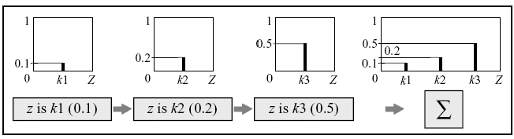

Sugeno-style aggregation of the rule outputs

Slide 6
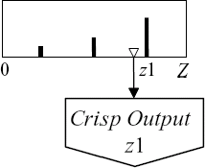

Weighted average (WA):
Sugeno-style defuzzification
6

Slide 7

Mamdani or Sugeno?
Mamdani method
  Widely accepted for capturing expert knowledge.
  Allows description of the expertise in more intuitive, more human-like manner.
  Entails a substantial computational burden.
Sugeno method
  Computationally effective
  Works well with optimisation and adaptive techniques
  Makes it very attractive in control problems, particularly for dynamic nonlinear systems.
7

Slide 8
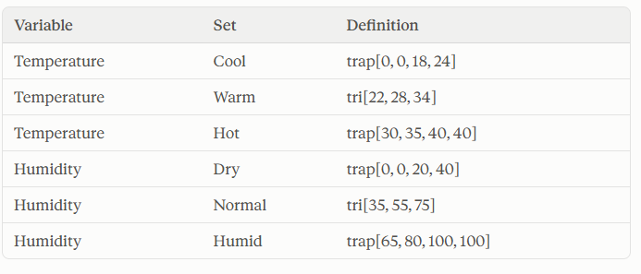
Exercise
Design a Sugeno-style fuzzy inference system to adjust fan speed based on Room Temperature and Relative Humidity.
Universes of discourse: Temperature (°C): 0–40; Humidity (%): 0–100; Fan Speed (% of maximum): 0–100.
Input fuzzy sets.
Trapezoid is trap[a, b, c, d]: membership rises from 0 at a to 1 at b, stays 1 until c, and falls to 0 at d.
Triangle is tri[a, b, c]: membership is 0 at a, 1 at b and 0 at c.

Slide 9
Output (fuzzy singletons): Low = 10, Medium = 50, High = 90.
Rule base:
IF Temperature is Cool AND Humidity is Dry THEN Fan Speed is Low
IF Temperature is Warm AND Humidity is Normal THEN Fan Speed is Medium
IF Temperature is Hot AND Humidity is Humid THEN Fan Speed is High
IF Temperature is Hot AND Humidity is Dry THEN Fan Speed is Medium
IF Temperature is Cool AND Humidity is Humid THEN Fan Speed is Medium
For Temperature = 31 °C and Humidity = 70 %:
(a) Fuzzify both inputs, sketching the membership functions and marking the readings.
(b) Compute the firing strength of each rule, using min for AND.
(c) Sketch the aggregated singleton output and compute the crisp fan speed by the weighted-average method.

